Slide 1
Irony & Symbolism
Authors love to use irony—to make readers expect one thing but give them another. That’s the fun of irony.
Symbols lend meaning to a story by evoking an unexpected emotional response. They are some of the most powerful devices a writer has to expand and deepen meaning.

Slide 2
Irony
This course examines the somewhat elusive quality of irony, the different forms it takes, and why authors use it.
I can't define it . . . but I know it when I see it.
—Justice Potter Stewart U.S. Supreme Court

Slide 3
Seeing Irony
That remark—"I know it when I see it"—is actually about pornography. But it applies equally well to irony. Shelves of books and countless graduate seminars have tried to dissect irony, understand it, and pin it down. But like humor, irony can prove just as elusive. This course will serve as an introduction to irony and an attempt to explain its remarkable qualities.

Slide 4
Seeing Irony
Irony is all over the place! Loosely defined, it's the opposite of what is expected or intended.
Unintended consequences —a miracle drug meant to cure one illness causes another.
Deviation from a pattern —after a long dry spell it rains—the very day you plan a picnic.
Deceptive appearances —the dumb blond gets the top grade in calculus.

Slide 5
Seeing Irony
Authors have been using literary irony for thousands of years. It comes in 3 distinct flavours:
Verbal irony —what's said is not what's meant. Sarcasm is a type of verbal irony.
Situational irony —what happens is the opposite of what's expected or desired.
Dramatic irony —readers know things that characters do not. We're “in the know.”

Slide 6
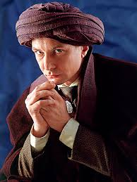
Verbal Irony
Julius Caesar (Shakespeare)—in his famous oration to the crowd, Marc Anthony calls Brutus "an honorable man," knowing that Brutus was one of Caesar's assassins.
In Harry Potter and the Order of the Phoenix, Harry says, "Yeah, Quirrell was a great teacher. There was just that minor drawback of him having Lord Voldemort sticking out of the back of his head!"

Slide 7
Situational Irony
"The Gift of the Magi" (O'Henry)—a young wife cuts and sells her hair to buy her husband a watch chain. The husband sells the watch to buy her a comb.
The Harry Potter series by J.K. Rowling - Throughout the books, Harry Potter is expected to kill Voldemort, but he eventually realizes he must allow Voldemort to kill him instead. This is a major reversal in what was expected throughout the books.
"The Story of an Hour" (Chopin)—Mrs. Mallard dies of sorrow when her supposedly dead husband walks through the door.

Slide 8
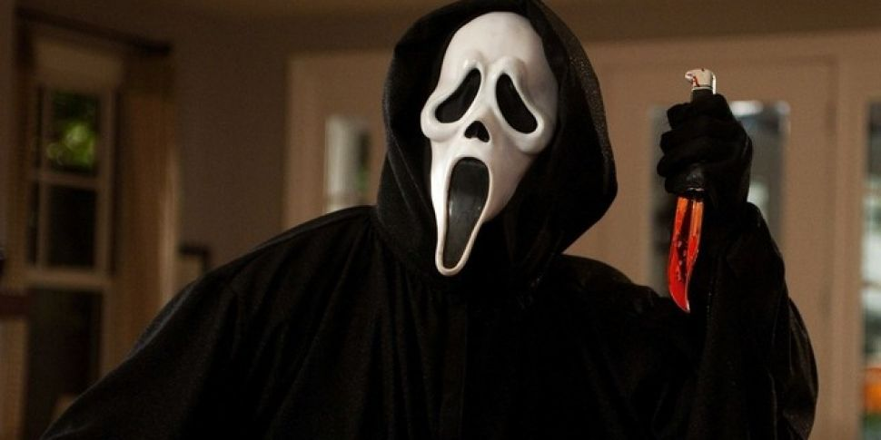
Dramatic Irony
Romeo decides to kill himself, thinking Juliet is dead when we all know she's just in a deep sleep. I like to think of dramatic irony as those times in the movie theater where you're yelling at the screen.
In a scary movie, the character goes into a house they think is empty, but the audience knows the killer is in the house. This increases the suspense …

Slide 9
Symbolism
Symbols lend meaning to a story by evoking an emotional response. They are some of the most powerful devices a writer has to expand and deepen meaning.

Slide 10
Symbols—conventional
Conventional symbols carry tremendous emotional power, evoking visceral responses both positive and negative.
• Cross • Eagle • Serpent • Statue of Liberty • Grim Reaper • Swastika

Slide 11
Symbols—conventional
Symbols allow us to convey powerful meaning without having to use words. They often represent the ineffable, what we can't easily put into words. Take flowers, used for both weddings and funerals:
Weddings—suggest the beauty of youth and the freshness of new love, fertility
Funerals—suggest the brevity and fragility of life on earth, AND everlasting life because flowers die and are reborn in spring.

Slide 12
Symbols—conventional
Notice how flower symbolism alters with context. Symbols are fluid, not static: their meanings may change with time, situation, culture or geography.
Serpent | • wisdom in ancient cultures • sin in Judeo-Christian culture
White | • purity in Western cultures • purity in Eastern cultures
Dragon | • evil in medieval Europe • good luck in China

Slide 13
Symbols—archetypes
Some symbols are universal, transcending time and geography. Known as archetypes, they call up deep unconscious responses, almost as if they were hard wired into our brains.
Archetypes as universal symbols • Women—connected to earth and water (fertility) • Light—beneficence and knowledge • Darkness—threatening and ignorance

Slide 14
Symbols—literary
Symbols play the same role in literature that they play in real life: they convey meaning. Writers embed symbols in their works. Skillful writers do it subtly, making symbols an integral part of the plot.

Slide 15
Symbols—literary
Because symbols carry so much power, writers use them to expand or intensify what they want to say—without having to come out and say it.
Writers use symbols . . . • to reinforce and enlarge meaning • to help them write economically

Slide 16
Symbols—literary
Let's look at more examples of how authors use symbolism.
"The story of an Hour" Kate Chopin (LitCourse 1) •The window opening onto fresh spring air suggests the opening of a new life for Mrs. Mallard. •Blue skies suggest hope for a new life. •The sound of birds and music contribute to the activity and pleasure that await Mrs. Mallard.

Slide 17
Symbols—literary
Tobias Wolff "Powder"
The father likes jazz—Tobias Wolff's way of telling us that Doc likes to live spontaneously without strict rules.
Snow represents the thrills that the father loves, but that scare the boy
The roadblock that the boy removes is a symbolic threshold that he passes, he starts to enjoy the excitement of living without complete foreknowledge and planning.
Powder becomes a symbol for something fresh, a new beginning, covering up of the old tracks, old habits, and offering an opportunity to lay down new tracks.

Slide 18
Symbols—a quick review
Symbols—objects, people, and events that stand for something other than themselves.
Conventional—found in daily life.
Archetype—age-old universal patterns.
Literary—suggestive, fluid, not absolute.

Slide 19
Congratulations!
You've reached the end of the Lecture.
Now read “The Open Window” by Saki

